Slide 1

anipaths
Animation of Multiple Trajectories with Uncertainty
2020-05-18

Slide 2
Outline
Introduction
Recent Updates
Usage
Getting Started
Examples

Slide 3
Introduction
Animation of observed trajectories
GAM model
crawl model
multiple trajectories simulations
Can be use in EDA and presentations
Created and maintain by Prof. Henry Scharf
Collaborator: Kristine
Published to CRAN on 2021-05-17

Slide 4
Recent Updates
GAM-based interpolation
Single trajectory
One main function
GAM and crawl-based interpolation
Multiple trajectories with uncertainty
Main function and internal functions
Different types of animation points
Incorporate the use of tidyverse package
Initiate test cases using testthat

Slide 5
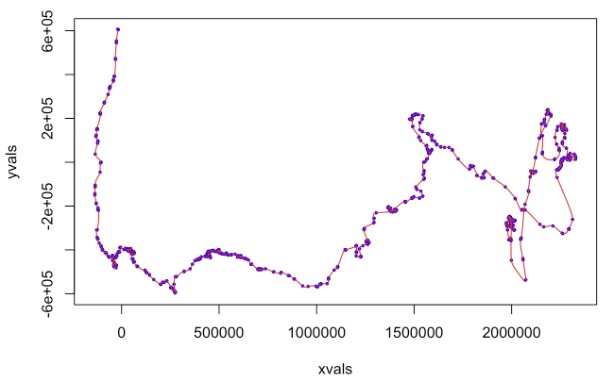
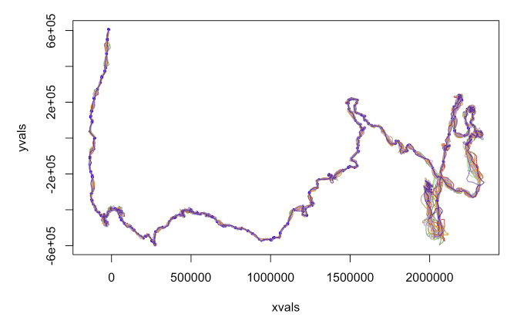
Single vs Multiple Trajectories

Slide 6

Usage of the Updates
Benefits of new interpolation:
Based on correlated random walk model
More consistent with real animal movement
Simulate multiple realizations
Depict uncertainty
New plot methods:
Points with tails
Blurry points with tails (diameter depends on uncertainty)

Slide 7
Getting Started
Install dependency packages
Then, install anipaths from CRAN
install.packages(“anipaths”)
Load dependencies
library(anipaths)
library(tidyverse)
library(magrittr)

Slide 8
Example: Data pre-processing
vultures %<>%
mutate(POSIX = as.POSIXct(timestamp, tz = "UTC"))
vultures_spring11 <- vultures %>%
filter(
POSIX > as.POSIXct("2011-04-05", origin = "1970-01-01") &
POSIX < as.POSIXct("2011-05-05", origin = "1970-01-01") &
(individual.local.identifier %in%
c('Argentina', 'Domingo', 'La Pampa', 'Whitey', 'Young Luro’))
)

Slide 9
Example: Simple Animation Using crawl Interpolation with Tails by days
animate_paths(paths = vultures_spring11,
delta.t = "day",
coord = c("location.long", "location.lat"),
Time.name = "POSIX",
ID.name = "individual.local.identifier",
interpolation_type = "crawl",
simulation = TRUE)

Slide 10
Example: Blurry Points Animation Using crawl Interpolation with Tails by hours
animate_paths(paths = vultures_spring11,
delta.t = 3600 * 6,
coord = c("location.long", "location.lat"),
Time.name = "POSIX",
ID.name = "individual.local.identifier",
interpolation_type = "crawl",
crawl.plot.type = "blur.tail")

Slide 11
Example: Animation Using crawl Interpolation with Tails and Background
background <- list(center = c(-70, -20), zoom = 4, maptype = "satellite")
library(ggmap) # and Register our API key using function register_google()
animate_paths(paths = vultures_spring11,
delta.t = 3600 * 6,
coord = c("location.long", "location.lat"),
Time.name = "POSIX",
ID.name = "individual.local.identifier",
background = background,
interpolation_type = "crawl",
simulation = TRUE)

Slide 12
References
anipaths on CRAN: https://cran.r-project.org/web/packages/anipaths/index.html
Multiple realizations vignette: https://cran.r-project.org/web/packages/anipaths/ vignettes/anipaths_crawl.html
crawl package: https://cran.r-project.org/web/packages/crawl/index.html

